Slide 1
INSTRUCTION EXECUTION CYCLE WITH INTERRUPTS
Computer Organization and Assembly Language
Computer Science Department
National University of Computer and Emerging Sciences Islamabad

Slide 2
Instruction Execution Cycle

Slide 3

INSTRUCTION CYCLE
Two steps:
  Fetch
  Execute

Slide 4
FETCH CYCLE
Program Counter (PC) holds address of next instruction to fetch
Processor fetches instruction from memory location pointed to by PC
Increment PC
  Unless told otherwise
Instruction loaded into Instruction Register (IR)
Processor interprets instruction and performs required actions

Slide 5
EXECUTE CYCLE
Processor-memory
  data transfer between CPU and main memory
Processor I/O
  Data transfer between CPU and I/O module
Data processing
  Some arithmetic or logical operation on data
Control
  Alteration of sequence of operations
  e.g. jump
Combination of above

Slide 6
INSTRUCTION EXECUTE CYCLE
Instruction
Fetch
Obtain instruction from program storage
Instruction
Decode
Determine required actions and instruction size
Operand
Fetch
Infinite Cycle
Locate and obtain operand data
Execute
Compute result value and status
Writeback
Result
Deposit results in storage for later use

Slide 7
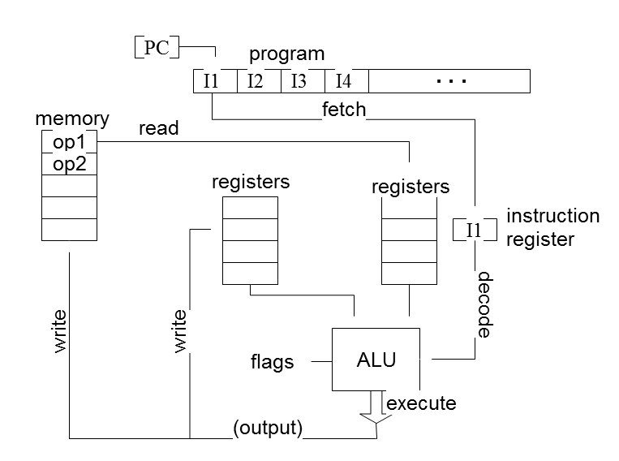
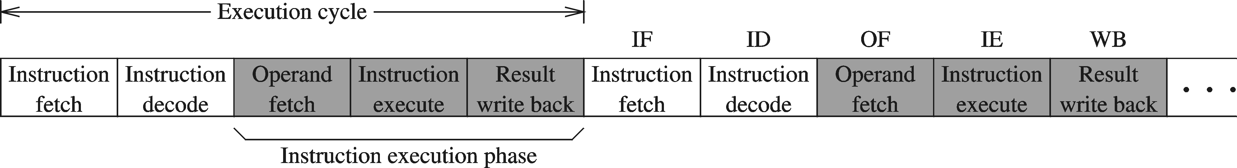
INSTRUCTION EXECUTION CYCLE – CONT'D
Instruction Fetch
Instruction Decode
Operand Fetch
Execute
Result Writeback

Slide 8
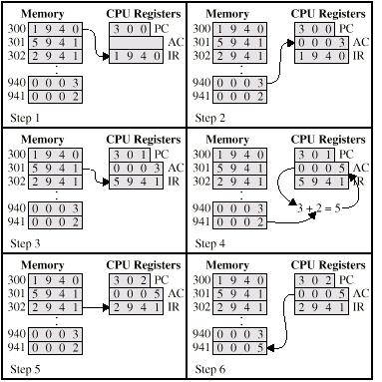
EXAMPLE OF PROGRAM EXECUTION
Figure 3.4 Characteristics of a Hypothetical Machine

Slide 9
Interrupts

Slide 10
INTERRUPTS
Mechanism by which other modules (e.g. I/O) may interrupt normal sequence of processing
Program
  e.g. Arithmatic overflow, division by zero
Timer
  Generated by internal processor timer
  Used in pre-emptive multi-tasking
I/O
  from I/O controller
Hardware failure
  e.g. Power failure, memory parity error
Notes:
I/O—to signal normal completion of an operation or to signal a variety of error conditions
Parity Error-A parity error was detected within the system memory. Parity checking is used to detect memory corruption between the time that data is written to memory and the time that it is read back.This error message means that there is a problem associated with the system memory.

Slide 11
INTERRUPTS
The normal execution of the current program must be interrupted – the device raises an interrupt signal.
Interrupt-service routine
Current system information backup and restore (PC, general-purpose registers, control information, specific information)

Slide 12
INTERRUPT CYCLE
Added to instruction cycle
Processor checks for interrupt
  Indicated by an interrupt signal
If no interrupt, fetch next instruction
If interrupt pending:
  Suspend execution of current program
  Save context
  Set PC to start address of interrupt handler routine
  Process interrupt
  Restore context and continue interrupted program

Slide 13
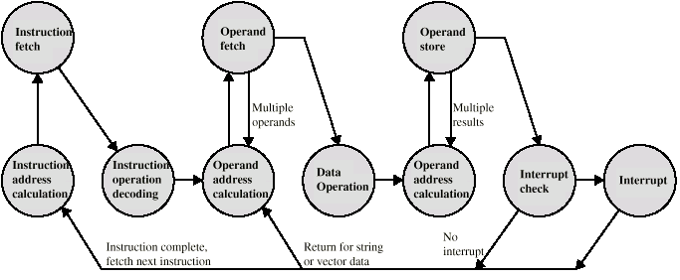
INSTRUCTION CYCLE (WITH INTERRUPTS) - STATE DIAGRAM

Slide 14

INSTRUCTION CYCLE WITH INTERRUPTS

Slide 15

TRANSFER OF CONTROL VIA INTERRUPTS

Slide 16
MULTIPLE INTERRUPTS
Disable interrupts
  Processor will ignore further interrupts whilst processing one interrupt
  Interrupts remain pending and are checked after first interrupt has been processed
  Interrupts handled in sequence as they occur
Define priorities
  Low priority interrupts can be interrupted by higher priority interrupts
  When higher priority interrupt has been processed, processor returns to previous interrupt

Slide 17

MULTIPLE INTERRUPTS - SEQUENTIAL

Slide 18
MULTIPLE INTERRUPTS – NESTED

Slide 19
REFERENCE
Computer Organization & Architecture By William Stallings (9th Edition)
Section 3.2
Chapter # 3

